Slide 1
Portfolio

Slide 2
About ME
I'm Vansh Mahajan, currently pursuing a B.Tech at VIT, Vellore, with a passion for Artificial Intelligence and Machine Learning (AIML). Raised in Jammu, I developed a deep interest in AIML during my schooling. At VIT, I'm dedicated to mastering AIML concepts, exploring algorithms, and engaging in hands-on projects and competitions. I'm fascinated by AIML's potential to revolutionize industries and solve complex problems. My goal is to leverage AIML to drive innovations and contribute to building a smarter future.
With a steadfast commitment to learning and a passion for AIML, I am excited to embark on this journey of exploration and discovery, fueled by the endless possibilities that lie ahead in the realm of technology

Slide 3

Project overview

Slide 4
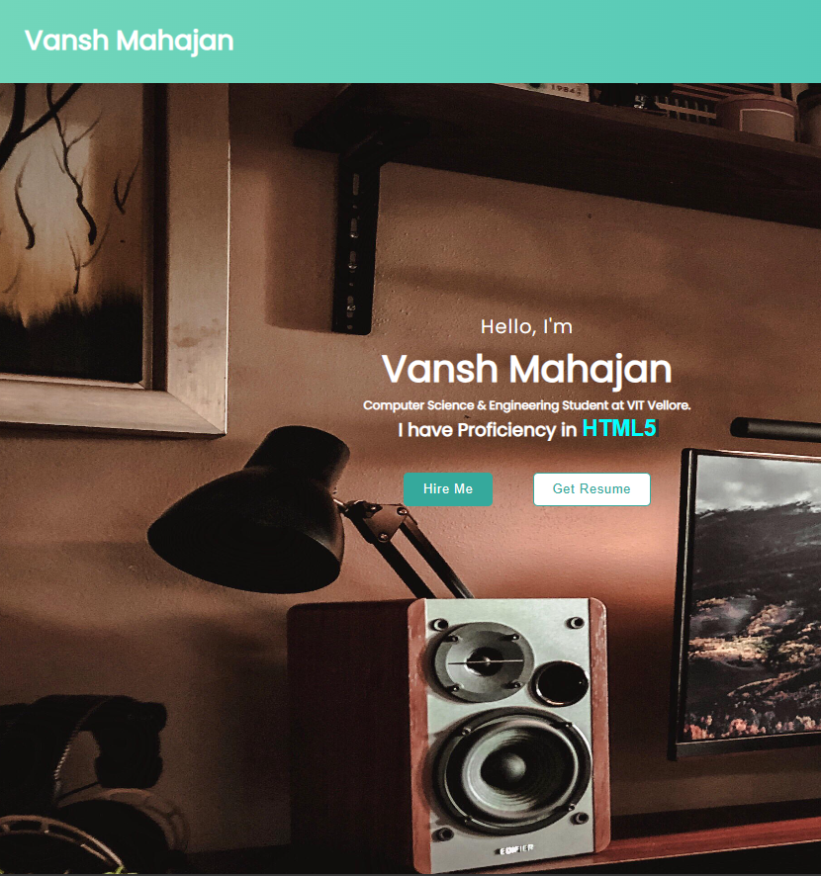
Product overview
First Web Portfolio designed product that's both stylish and functional

Slide 5
CONTENTS
Home: A simple landing page with my name and a button to
hire me and a button to contact me
About: A bit about myself
Education: My education qualifications
Skills: Skills that I have developed over the years
Projects: Some of the projects I have developed over the years
Contact me: My Contact info(my email & my Phone number) ,my residential address etc.
Social: Link to my social accounts Linked in, My Insta, My
Git ,My Twitter

Slide 6

Product Details
Online store and market swap

Slide 7
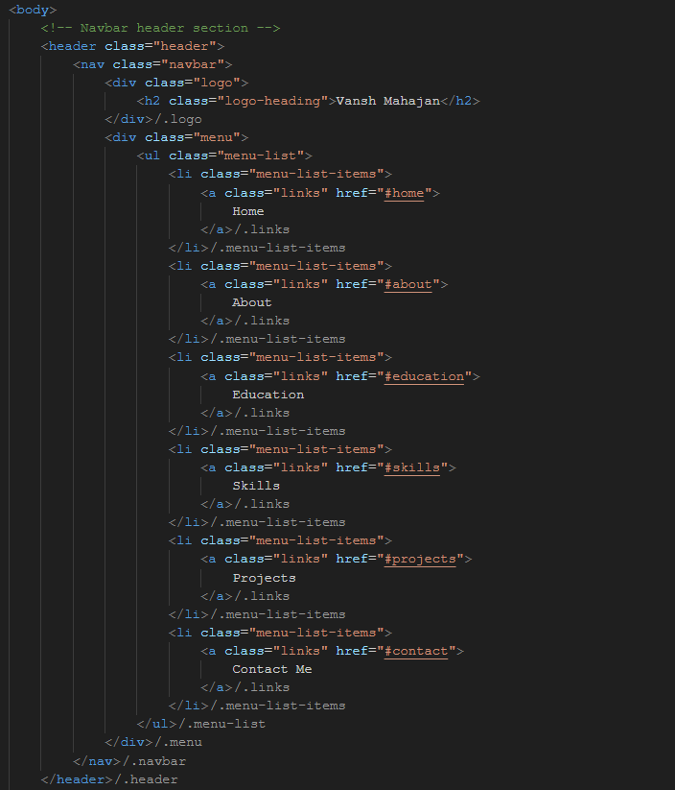
nAVBAR
href=#skills will take you to skill section

Slide 8
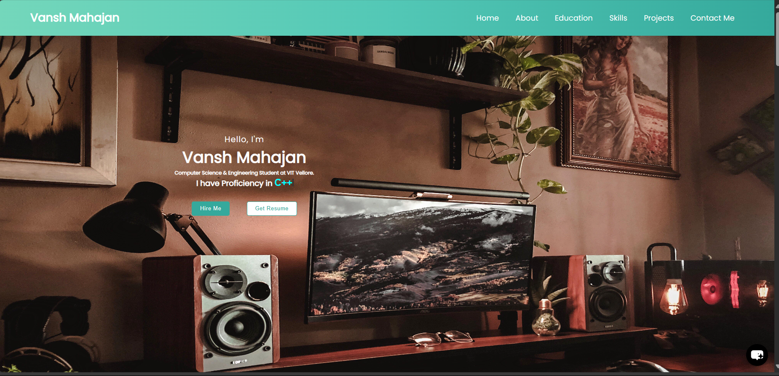
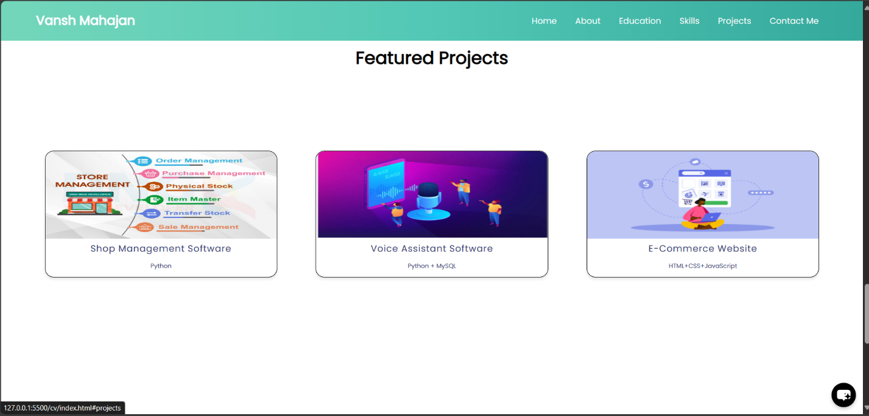
navbar
For example if you click “Projects” you will be redirected to the section of Page containing my “Featured projects”.
If you click on any of them you will be redirected to that part of the page.

Slide 9
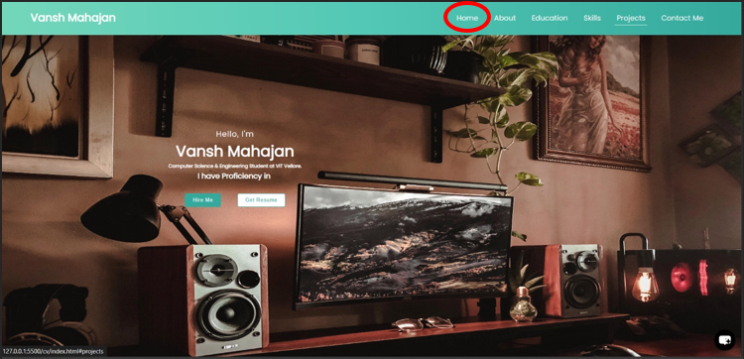
home page
The hero section features a background image and centered text content, styled with CSS to create an attractive introduction

Slide 10
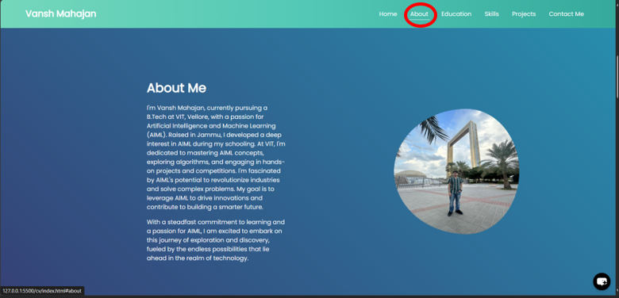
ABOUT
Information about the website owner is presented with text and an accompanying image, arranged using flexbox for layout control.

Slide 11
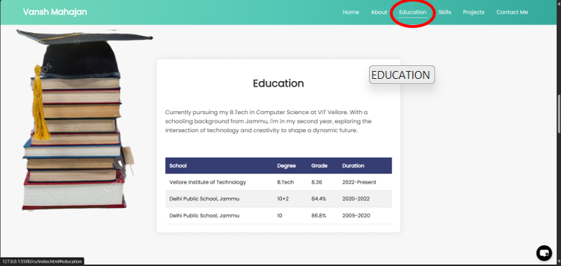
EDUCATION
A table layout is used to display educational qualifications, enhancing readability and organization of content

Slide 12
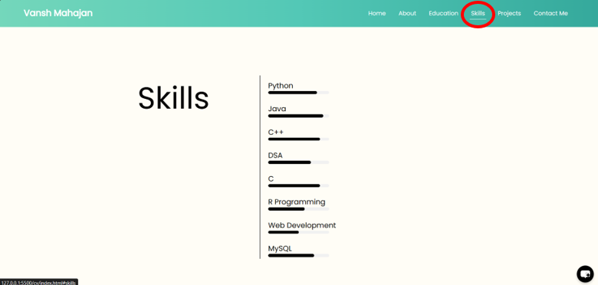
SKILLS
Skills are listed with accompanying progress bars, indicating proficiency levels. Hover effects are added to the skills list items for user interaction.

Slide 13
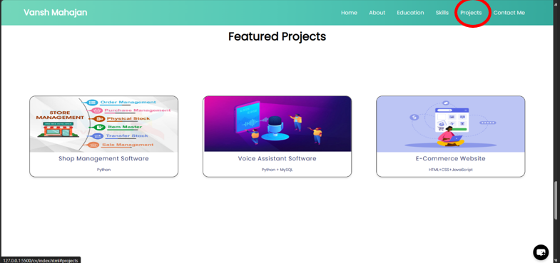
featured projects
Featured projects are showcased with images and brief descriptions in a grid layout, utilizing flexbox for alignment and styling.

Slide 14
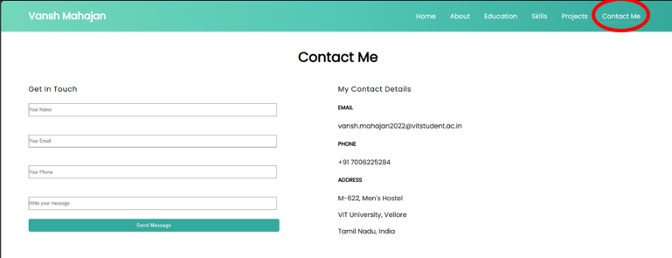
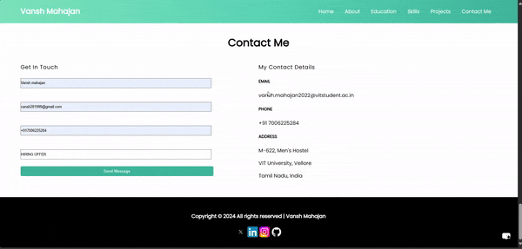
Contact me
A contact form is provided for users to send messages, with form validation and a modal notification upon successful submission..

Slide 15
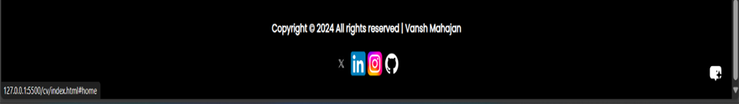
social links
Social media links are included in the footer section, allowing visitors to connect with the website owner on various platforms.

Slide 16
Techniques used
HTML5 and CSS3: The website structure and styling are built using HTML5 and CSS3, ensuring semantic markup and responsive design.Design is simple and easy to use, compared to the complex designs of the competitors
JavaScript: JavaScript is utilized for interactivity and dynamic content manipulation, including form submission handling and modal display.
Navbar: A fixed navbar is implemented using flexbox to provide navigation across different sections of the website. It includes “Home” “About” “Education” “Skills” “Projects” “Contact Me” .
Contact Section: A contact form is provided for users to send messages, with form validation and a modal notification upon successful submission
Social Links: Social media links are included in the footer section, allowing visitors to connect with the website owner on various platforms.
Cursor Animation: The blinking cursor effect is achieved using CSS animations (@keyframes) applied to the ::after pseudo-element of the #head element, simulating a typing animation

Slide 17
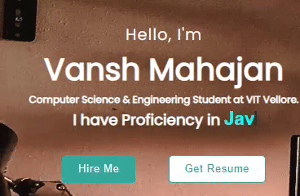
cursor animation and changing text
The blinking cursor effect is achieved using CSS animations (@keyframes) applied to the ::after pseudo-element of the #head element, simulating a typing animation.
The changing text in the div.intro of the hero section is implemented using JavaScript. The text content is dynamically updated to display different phrases, providing a dynamic and engaging introduction.

Slide 18
cursor animation and changing text
To achive this animation we use following JS
const words = ["Python", "JavaScript", "HTML5" , "CSS" , "Kotlin" , "C++" , "Java" ,"Assembly" , "Machine Learning" ];
let currentWordIndex = 0;
function typeEffect(header, newText, speed, callback) {
let index = 0;
function typeCharacter() {
header.innerText = newText.substring(0, index + 1);
index++;
if (index >= newText.length) {
clearInterval(interval);
if (callback) {
setTimeout(callback, 500);
}
}}
const interval = setInterval(typeCharacter, speed);
}

Slide 19
cursor animation and changing text
function backspaceEffect(header, callback) {
let currentText = header.innerText;
let index = currentText.length;
function deleteCharacter() {
header.innerText = currentText.substring(0, index - 1);
index--;
if (index <= 0) {
clearInterval(interval);
if (callback) {
callback();
}
}
}
const interval = setInterval(deleteCharacter, 100);
}

Slide 20
cursor animation and changing text
function typeNextWord(header) {
backspaceEffect(header, () => {
currentWordIndex = (currentWordIndex + 1) % words.length;
const nextWord = words[currentWordIndex];
typeEffect(header, nextWord, 100, () => {
setTimeout(() => {
typeNextWord(header);
}, 1000); }
});
});
const header = document.getElementById('head');
typeNextWord(header);

Slide 21
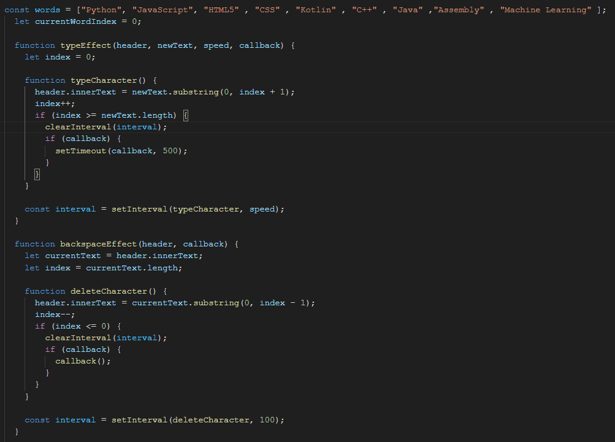
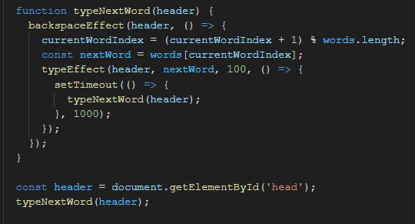
cursor animation and changing text (SNAPSHOT)

Slide 22
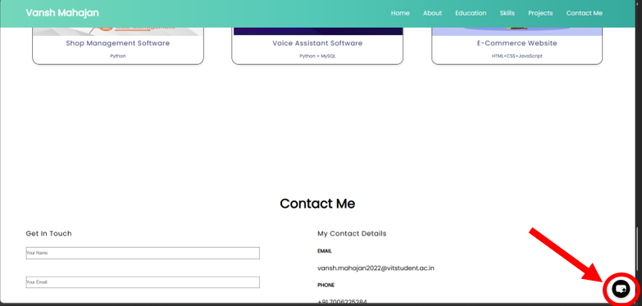
chat bot
This is in experimental thing I have used an external website “"https://www.chatbase.co/embed.min.js"”

Slide 23
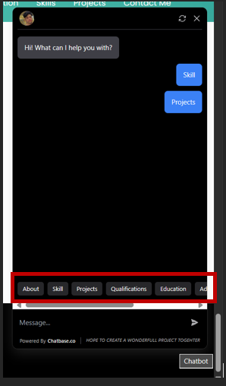
chat bot
You can interact with the chat bot and you can also use the pre defined (recommended) messages given below (About skill Projects Qualifications Education Contact email etc.)

Slide 24
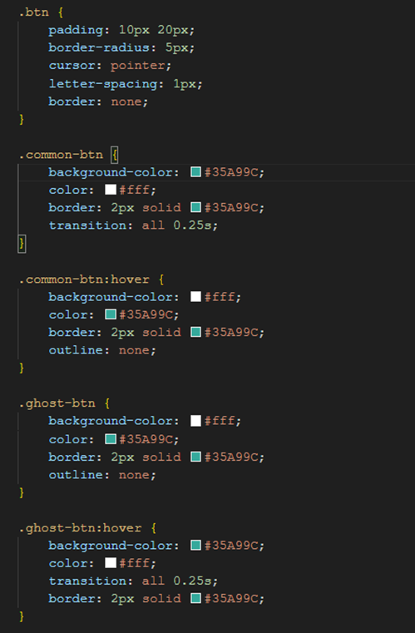
Hover effect
CSS:

Slide 25
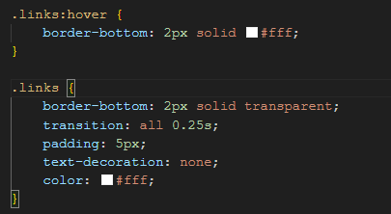
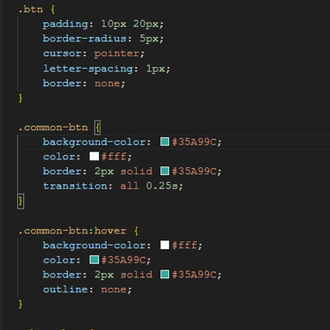
Hover effect
CSS:

Slide 26
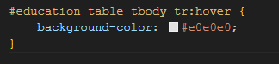
Hover effect
CSS:

Slide 27
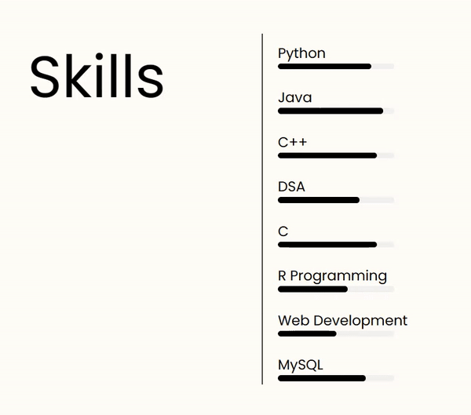
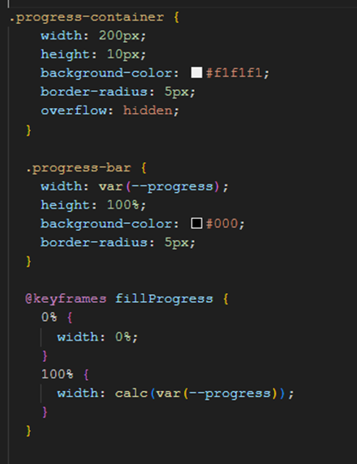
Hover effect
CSS:

Slide 28
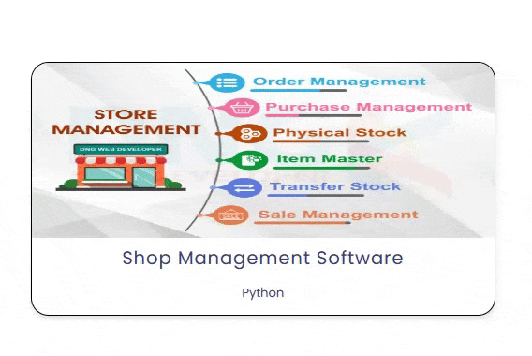
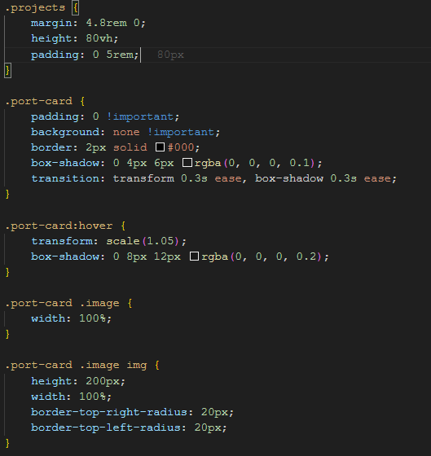
Hover effect
CSS:

Slide 29
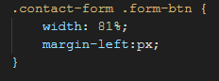
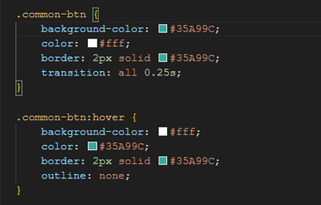
Hover effect
Html:
CSS:

Slide 30
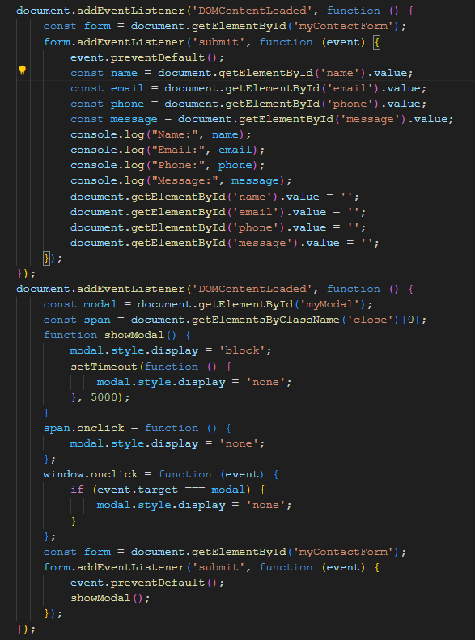
submit
JS:

Slide 31
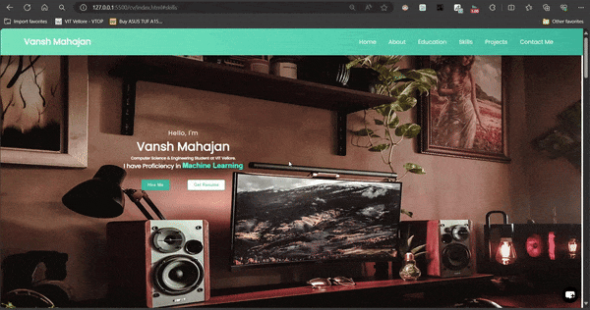
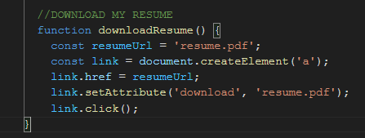
GET RESUME
Html:
JS:

Slide 32
explanation
Firstly, we are setting the address of the PDF file we want to download. Think of it like telling the computer where to find the file.
Then we're creating a special clickable link on the webpage, just like those you click to navigate to other pages on the internet. (<a> element)
After that we're telling that link where it should take us when clicked, which in this case is the PDF file.
Then we specify that when someone clicks this link, the browser should download the file instead of just opening it in the browser window.
By link.click(), We're telling the computer to pretend like someone clicked on that link, so it starts the download process automatically.
In conclusion,
The download attribute is set directly on the anchor element (link). Then, the click() method is called directly on the anchor element, which initiates the download of the file specified by the href attribute. This approach eliminates the need to append and remove the element from the document body, making the code shorter and more concise.

Slide 33
OVERWIEW
Home: The homepage introduces about myself and provides buttons for hiring and downloading his resume. About: This section offers a detailed overview of My background, interests, and academic pursuits. Education: My educational journey, including his current pursuit of a B.Tech in Computer Science at VIT Vellore, is showcased here. Skills: My proficiency in various programming languages and technologies is visually represented using dynamic progress bars. Projects: Featured projects, including Shop Management Software, Voice Assistant Software, and E-Commerce Website, are highlighted with brief descriptions. Contact Me: Visitors can get in touch with me via a contact form or find his contact details for direct communication.

Slide 34

Thank you
Vansh Mahajan
vansh.mahajan2022@vitstudent.ac.in
7006225284
VIT University,Vellore,
Tamil Nadu, India

